Slide 1

Mini-Grants Bid Process
JJAG Update
Trista Deame, Chief of Criminal Justice Program Planning and Development, Office of Youth Justice
December 2024
Notes:
Cover Slide

Slide 2
Timeline
Notes:
Section Slide

Slide 3
Mini-Grants Bid Process Timeline: 2024
JJAG Approve Funding Proposal
Bid Request Made Live
Bid Request Closed
Grantees Selected
Grantees Notified
June 18th
Sept
16th
Oct
16th
Nov
12th
Dec
DIVISION OF CRIMINAL JUSTICE SERVICES
3
Notes:
Bid Process and Selection Criteria: Working with the Office of Program Funding and Development (OPDF), DCJS Office of Youth Justice Program Team developed and released a bid request soliciting workplans and budgets to support programming in the thematic areas identified above. The request was live from September 16, 2024, through October 16, 2024. Responses were submitted via the online platform, Alchemer. The funding opportunity was shared widely amongst DCJS OYJ contacts, platforms, and listservs. Over the course of the 30- day period a total of 84 completed applications were submitted for funding.

Slide 4
Mini-Grant Application: Instructions
To complete your application, please provide a detailed work plan and budget. All funding provided must support program efforts during the project period. Funding requests not directly related to the work plan will not be granted.
Allowable Costs: Examples of allow able program categories for funding include, but are not limited to the following:
  Mentoring
  Mental health services
  Restorative practices
  Trauma and healing
  Positive youth development opportunities
  Community trust building
  Personnel and administrative overhead are also examples of allowable costs.
Examples of unallowable categories for funding include, but are not limited to, the following:
  Capital improvement projects
  Law enforcement equipment
DIVISION OF CRIMINAL JUSTICE SERVICES
4
Notes:
Online application submission via online platform – Alchemer

Slide 5
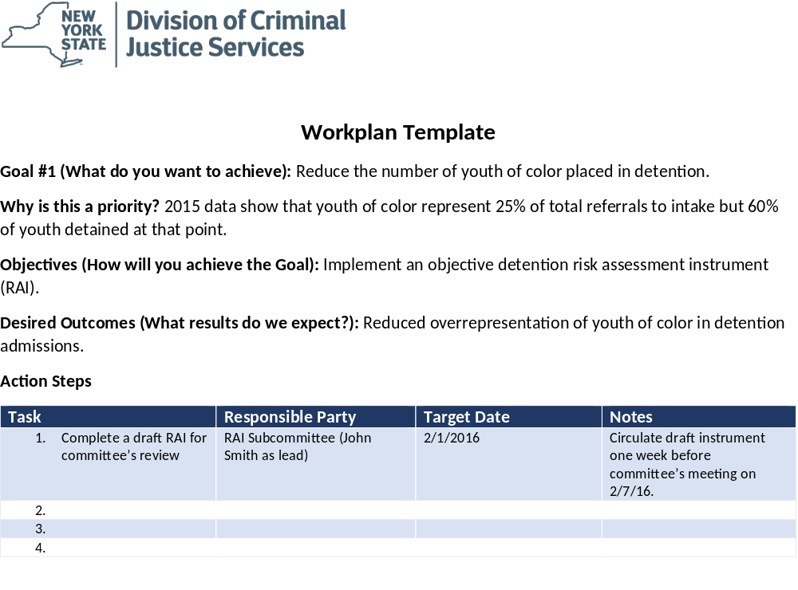
Mini-Grant Application: Workplan
DIVISION OF CRIMINAL JUSTICE SERVICES
5

Slide 6
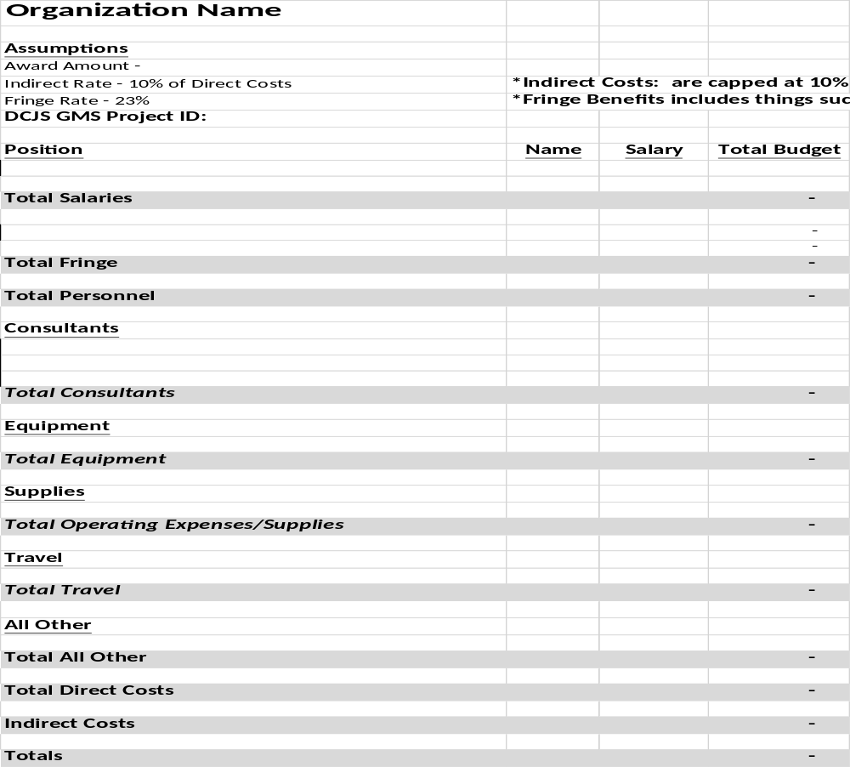
Mini-Grant Application: Budget
DIVISION OF CRIMINAL JUSTICE SERVICES
6

Slide 7
To evaluate the quality and completeness of the applications received, a scoring instrument was developed to capture organizational experience, completeness and comprehensiveness of the workplan submitted and program proposed as well as, the appropriateness of budget submitted to support the work. A pre-scoring meeting was held with reviewers to go over the intent of the bid request, the requirements for submission, as well as the scoring instrument and consistency in making scoring decisions. A total of five individuals who scored each application, the average score of each application was utilized in the decision-making process. Below is a quantitative summary of the received responses.
Total Number of Bids Received: 82
Total Number of Bids Disqualified in Initial Review: 24
Total Number of Bids Reviewed and Scored: 58
Reviewers included: Trista Deame, Alison Floyd, Courtney Murphy, and Omar Cyrille from OYJ; and Tonya Tamir from OPDF.
Responses were automatically disqualified if organizations were not pre-qualified in the State Financial System.
Mini-Grant Bid Response Results
DIVISION OF CRIMINAL JUSTICE SERVICES
7
Notes:
Reviewers included: Trista Deame, Alison Floyd, Courtney Murphy, and Omar Cyrille from OYJ; and Tonya Tamir from OPDF.
Responses were automatically disqualified if organizations were not pre-qualified in the State Financial System.

Slide 8
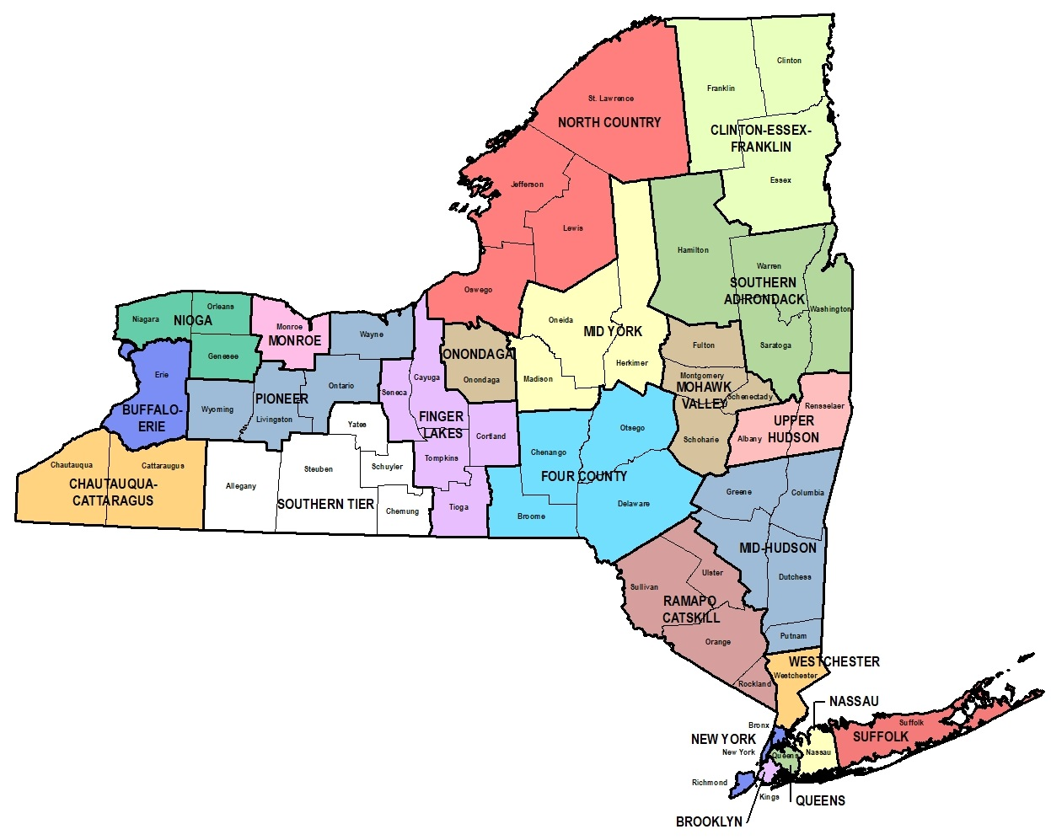
Murphy, and Omar Cyrille from OYJ; and Tonya Tamir from OPDF.
Responses were automatically disqualified if organizations were not pre-qualified in the State Financial System.
Mini-Grant Bid Response Results: Applied Geographic Locations
NYC – 20 applicants
ROS – 38 applicants
DIVISION OF CRIMINAL JUSTICE SERVICES
8

Slide 9
Murphy, and Omar Cyrille from OYJ; and Tonya Tamir from OPDF.
Responses were automatically disqualified if organizations were not pre-qualified in the State Financial System.
Mini-Grant Bid Response Results: Selected Geographic Locations
NYC – 6 grantees
ROS – 9 grantees
DIVISION OF CRIMINAL JUSTICE SERVICES
9

Slide 10
Reviewers included: Trista Deame, Alison Floyd, Courtney Murphy, and Omar Cyrille from OYJ; and Tonya Tamir from OPDF.
Responses were automatically disqualified if organizations were not pre-qualified in the State Financial System.
Mini-Grant Bid Response Results: Funded Programmatic Areas
Trauma, healing, and mental health services
Network of Peer Workgroups for justice involved youth and their caregivers
Restorative Justice and Restorative Practices
Family and Community Centered Prevention Programs; artivism, listening circles, and community engagement
Credible Messenger
School-based Programming; increased literacy and decrease in disciplinary incidents and reduce chronic and severe absenteeism amongst youth of color
SEL and RJ in facilitates
Community-trust building and healing
Culturally competent and dual language speaking mentors and therapists
Positive Youth Development Opportunities
DIVISION OF CRIMINAL JUSTICE SERVICES
10

Slide 11

Notes:
End slide

